Slide 1

GYM WORKOUT APP
Group Members:
Muhammad Umer
Anas Ali
Zeeshan Aijaz

Slide 2
Project Description
This project is a fitness cum gym application built on Flutter. This will be used by three type of users; 1. Admins, 2. Members, 3. Non-Members.
There will be preset Admins, who will be allowed to sign-in with their own email and password, stored in the database, and no other email and password will be accepted. Admin can register members and trainers and can search all the members with the help of this app. Admin can also mark attendance of members coming into the gym and can have a check on fees payment of the members and can mark the fees paid if member pays the amount.

Slide 3
Existing users registered as Members will be allowed to sign-in as Members with their own email and password. Their data will be stored in the database as well. Member can calculate his/her BMI, can view and update his/her information .
Non-members users, who are not registered, can also use the app to view the gym packages provided by the trainers.
Project Description (Continued)

Slide 4

Features
Sign-up and Login
Access to authorized users only
User dashboard
Registration
Multiple type of users can access the app (Admin, Member, Non-Member)
Information stored in Database
Fetching, insertion, deletion and updation of user’s data

Slide 5

Features Continued
BMI Calculator
Viewing of packages
Searching of all gym members, with their information
Member attendance checker
Payment checker

Slide 6
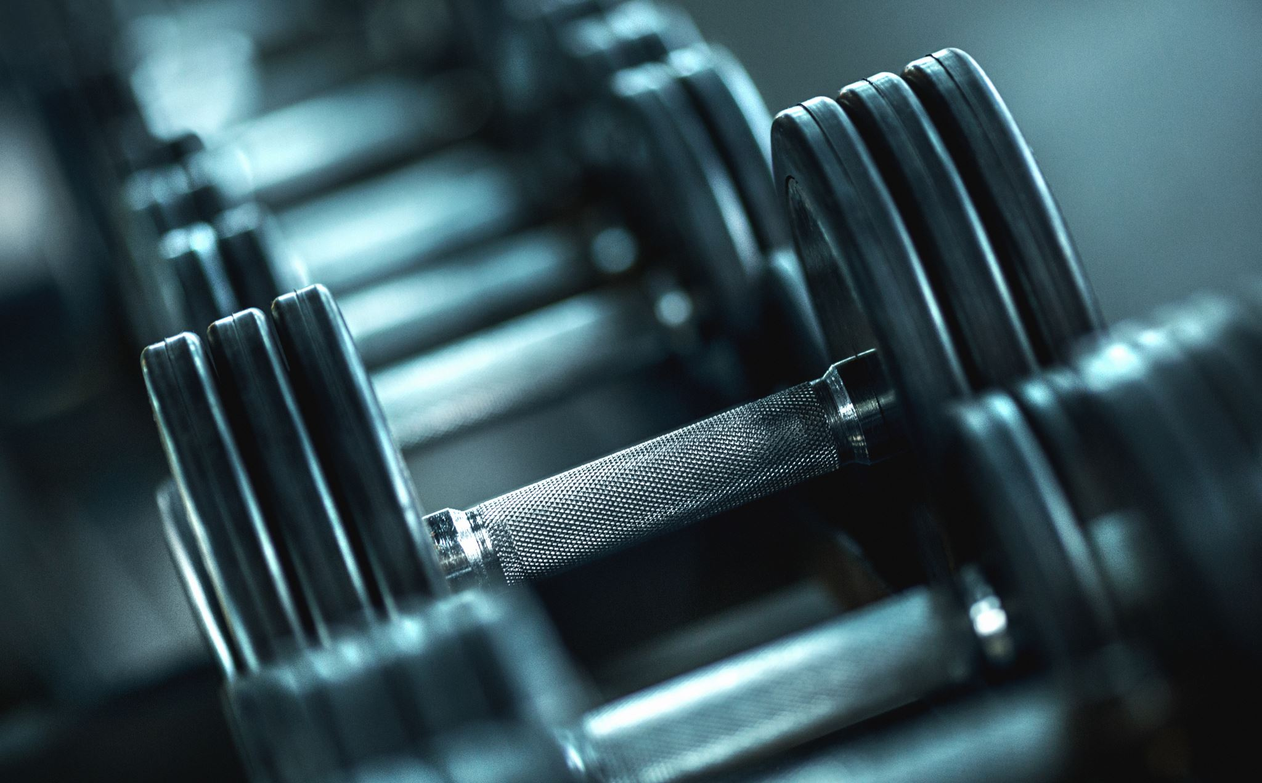
Feasibility
In today’s world, people have started to rely more on applications. They just need everything to be done within few taps on the screen. Instead of going to the gym and stand for hours just to get yourself registered, this application will help users to get registered anywhere anytime within seconds.
This application is absolutely free, with easiest UI and interface possible so that people with least knowledge of technology can also operate it.

Slide 7
Requirements
Operating System: Windows 7, 8, 10, 11 , Mac OS
RAM : >= 6 GB
Processor: Core i3,5,7 and above

Slide 8

Technology Used
Flutter version 2.0.0
Android Studio version 1.0.0
Visual Studio Code version 1.0.2
Supabase (for DBMS and backend)

Slide 9

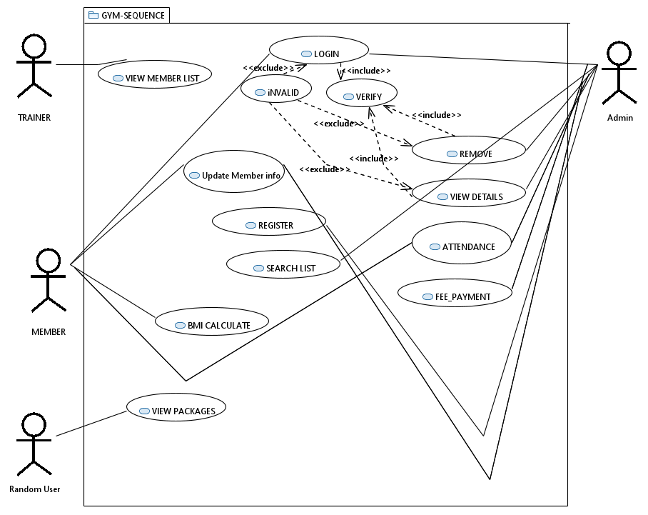
UML Description USE CASE

Slide 10
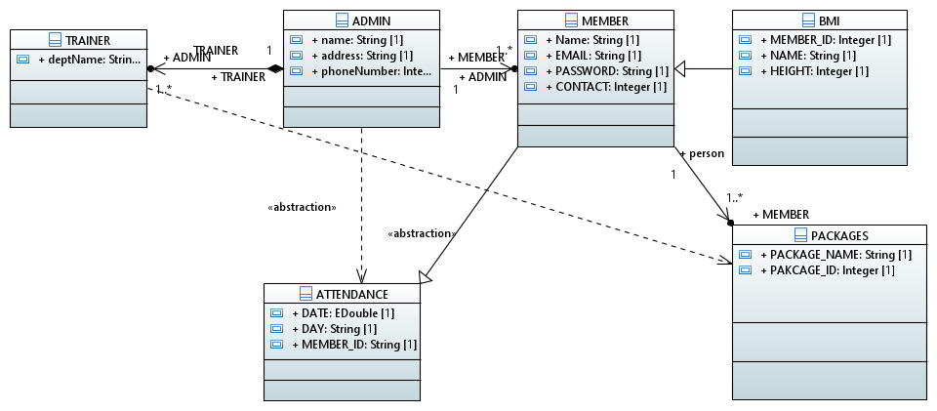
CLASS DIAGRAM

Slide 11
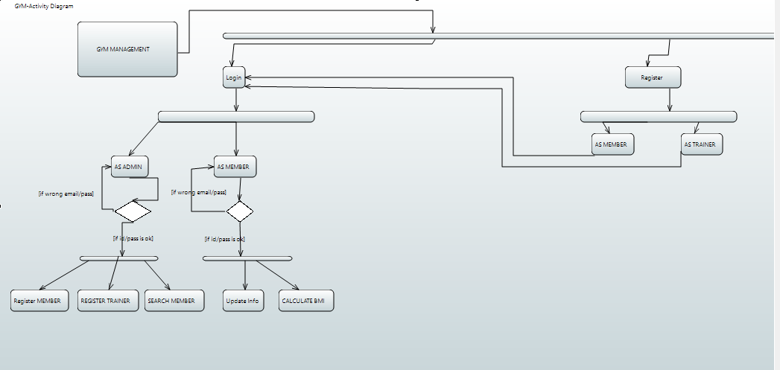
ACTIVITY DIAGRAM

Slide 12
THANKYOU

